Slide 1
E-Commerce App
Introduction:
Our E-commerce app is designed to provide a seamless shopping experience for users, allowing them to browse and purchase a wide range of products conveniently from the comfort of their own devices. Whether you are a customer looking to explore and buy products or an administrator managing the app's backend, this documentation will walk you through the various aspects of the app and provide you with the necessary information to make the most out of it.
Key Features:
Product Catalog: Our E-commerce app provides an extensive product catalog with various categories and subcategories. Users can easily search, browse, and filter products based on their preferences, making it effortless to find the desired items.
User Registration and Authentication: Customers can create user accounts, allowing them to save their shipping details, track orders, and manage their preferences. The authentication process ensures secure access to their personal information and order history.
Shopping Cart and Checkout: The app includes a shopping cart feature that enables users to add products, review their cart, and proceed to checkout. The checkout process offers multiple payment options, ensuring a smooth and secure transaction experience.
Product Reviews and Ratings: Customers can provide feedback and rate products, helping other users make informed purchasing decisions. This feature fosters a sense of community and trust among users.
Order Tracking: Once an order is placed, users can track its status in real-time. They receive updates on order processing, shipping, and delivery, providing transparency and peace of mind.
Admin Dashboard: For administrators, our E-commerce app offers a comprehensive dashboard to manage products, inventory, orders, and customer information. It provides insights into sales performance, stock levels, and customer analytics, enabling efficient business operations.

Slide 2
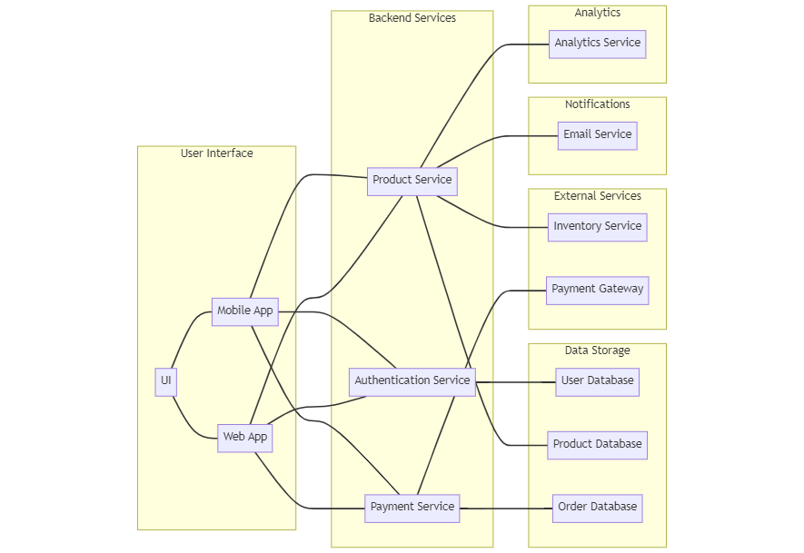
Technical Architecture:
The technical architecture of an e-commerce app typically involves a client-server model, where the frontend represents the client and the backend serves as the server. The frontend is responsible for user interface, interaction, and presentation, while the backend handles data storage, business logic, and integration with external services like payment gateways and databases. Communication between the frontend and backend is typically facilitated through APIs, enabling seamless data exchange and functionality.

Slide 3
Order Management: The app manages the order lifecycle, including order placement, tracking, and status updates. Users can view their order history, track shipments, and request returns or cancellations.
Search and Filtering: Users can search for products using keywords and apply filters to narrow down the search results based on criteria such as price range, brand, or customer ratings.
Overview: These are the basic features found in most e-commerce applications. However, depending on the specific requirements and complexity, e-commerce apps can include additional features like social sharing, personalized recommendations, advanced analytics, multi-language support, and integration with third-party services for shipping, inventory management, or marketing automation.
Roles and Responsibilities :
The project has two types of users – Seller and Customer. The roles and responsibilities of these two types of users can be inferred from the API endpoints defined in the code. Here is a summary:
Customer:
1. Create an account and log in to the system using their email and password.
2. Browse and search for products available on the platform.
3. View detailed product information, including description, price, and availability.
4. Add products to their cart for future purchase.
5. Proceed to checkout and place orders for selected products.
6. Make secure online payments for their orders.
7. Track the status of their orders.
8. Manage their profile information, including personal details and shipping addresses.
9. Provide feedback and reviews for products and sellers.
10. Access customer support for any queries or issues related to their orders.

Slide 4
Seller:
1. Create an account and log in to the system using their email and password.
2. Manage their product inventory, including adding new products and updating existing ones.
3. Set product details such as title, description, price, quantity, and images.
4. Monitor and fulfill orders received from customers.
5. Manage product categories and organize products accordingly.
6. Track sales and revenue generated from their products.
7. Interact with customers by responding to inquiries, resolving issues, and addressing feedback.
8. Access seller support for assistance with any platform-related concerns.
Admin:
1. Manage and monitor the overall operation of the e-commerce platform.
2. Approve and onboard new sellers.
3. Monitor and moderate product listings, ensuring compliance with guidelines and policies.
4. Handle customer disputes and resolve issues.
5. Manage user accounts, including customer and seller profiles.
6. Analyze platform performance and generate reports on sales, customer behavior, and product popularity.
7. Implement and enforce platform policies, terms of service, and privacy regulations.
8. Continuously improve the platform's functionality, user experience, and security measures.
These roles and responsibilities are aimed at ensuring a smooth and efficient operation of the e-commerce app, providing a seamless experience for customers, sellers, and administrators.

Slide 5
Installation Guide :
To install and run this job portal project, you can follow these steps:
1. Install Node.js and MongoDB on your machine.
2. Open a terminal and navigate to the project directory.
3. Run npm install command to install all the necessary packages listed in the package.json file.
4. Make sure MongoDB is running on your machine. You can start MongoDB by running mongod command in a separate terminal window.
5. Start the server by running node app.js or npm start command in the terminal window.
6. The server will start listening on port 3000, and you should see the message "Server listening on port 3000" in the console.
7. You can now access the API endpoints by sending HTTP requests to http:// localhost:3000 using a tool like Postman or any web browser.

Slide 6
Pre Requisites:
To develop a full-stack e-commerce app using AngularJS, Node.js, and MongoDB, there are several prerequisites you should consider. Here are the key prerequisites for developing such an application:
Knowledge of JavaScript: Strong knowledge of JavaScript is essential as both AngularJS and Node.js are JavaScript-based frameworks. Familiarize yourself with the fundamentals of JavaScript, including variables, functions, data types, and control flow.
Understanding of AngularJS: AngularJS is a popular JavaScript framework for building dynamic single-page applications. Learn the basics of AngularJS, including concepts like data binding, directives, services, and controllers. Familiarize yourself with AngularJS modules and the AngularJS application architecture.
Proficiency in Node.js: Node.js is a server-side JavaScript runtime environment. Gain a solid understanding of Node.js and its core modules. Learn how to use npm (Node Package Manager) to manage dependencies and build your application's server-side logic using Node.js.
Familiarity with MongoDB: MongoDB is a NoSQL database that stores data in flexible, JSON-like documents. Learn the basics of MongoDB, including document structure, collections, querying, and indexing. Understand how to connect your Node.js server to MongoDB using the appropriate MongoDB driver or an Object-Document Mapping (ODM) library like Mongoose.
RESTful API Development: Design and develop RESTful APIs to facilitate communication between the frontend and backend of your e-commerce app. Understand how to define routes, handle HTTP requests and responses, and implement authentication and authorization mechanisms using middleware.
HTML and CSS: Proficiency in HTML and CSS is essential for designing the user interface of your e-commerce app. Learn HTML tags, elements, and attributes, as well as CSS selectors, properties, and styling techniques to create visually appealing and responsive web pages.

Slide 7
Authentication and Authorization: Understand different authentication and authorization mechanisms to secure your e-commerce app. Explore concepts like token-based authentication, OAuth, and JWT (JSON Web Tokens). Implement user registration, login, and session management with appropriate security measures.
Payment Gateway Integration: E-commerce apps often require payment gateway integration to facilitate secure online transactions. Familiarize yourself with payment gateway APIs and understand how to integrate them into your application, ensuring proper handling of transactions and security measures.
Development Tools: Set up a development environment with the necessary tools. Install Node.js, MongoDB, and a code editor of your choice (e.g., Visual Studio Code). Familiarize yourself with debugging tools, version control systems (e.g., Git), and package managers like npm.
Testing and Deployment: Learn about testing methodologies and frameworks for both frontend and backend development. Explore unit testing, integration testing, and end-to-end testing techniques. Familiarize yourself with deployment strategies and hosting platforms to deploy your e-commerce app.
Remember that continuous learning and staying updated with the latest advancements in AngularJS, Node.js, and MongoDB are essential to build a robust and efficient e-commerce application. Documentation, online tutorials, and community resources are valuable sources of information during the development process

Slide 8
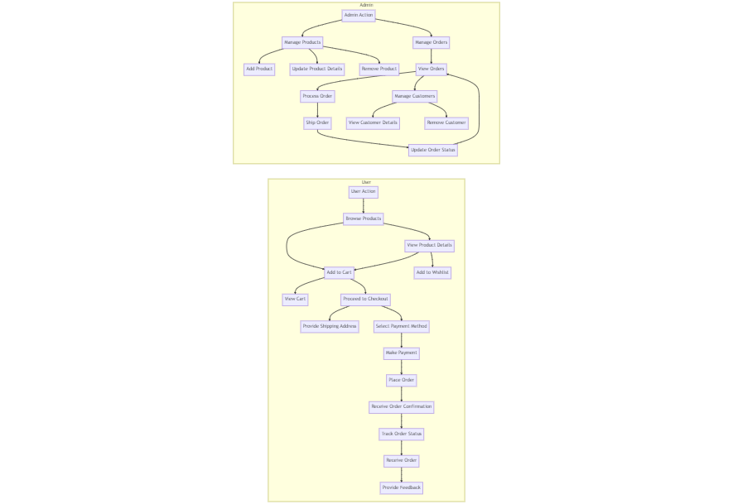
Project Flow:

Slide 9
.Project Structure:
├── src
│ ├── app
│ │ ├── components
│ │ │ ├── Register.js
│ │ │ ├── Login.js
│ │ │ ├── Home.js
│ │ │ ├── Products.js
│ │ │ ├── MyCart.js
│ │ │ ├── MyOrders.js
│ │ │ ├── PlaceOrder.js
│ │ │ ├── History.js
│ │ │ ├── Feedback.js
│ │ │ └── ProductDetails.js
│ │ ├── pages
│ │ │ ├── HomePage.js
│ │ │ ├── ProductListPage.js
│ │ │ ├── ProductDetailPage.js
│ │ │ ├── CartPage.js
│ │ │ ├── CheckoutPage.js
│ │ │ ├── OrdersPage.js
│ │ │ └── ...
│ │ ├── services
│ │ │ ├── AuthService.js
│ │ │ ├── ProductService.js
│ │ │ ├── CartService.js
│ │ │ ├── OrderService.js
│ │ │ └── ...
│ │ ├── utils
│ │ │ ├── APIUtils.js
│ │ │ ├── StorageUtils.js
│ │ │ └── ...
│ │ ├── App.js
│ │ ├── index.js
│ │ └── ...
└── ...

Slide 10
│ ├── admin
│ │ ├── components
│ │ │ ├── AddCategory.js
│ │ │ ├── AddProduct.js
│ │ │ ├── Dashboard.js
│ │ │ ├── Feedback.js
│ │ │ ├── Home.js
│ │ │ ├── Orders.js
│ │ │ ├── Payment.js
│ │ │ └── UpdateProduct.js
│ │ ├── pages
│ │ │ ├── DashboardPage.js
│ │ │ ├── OrdersPage.js
│ │ │ ├── ProductManagementPage.js
│ │ │ ├── UserManagementPage.js
│ │ │ └── ...
│ │ ├── services
│ │ │ ├── ProductService.js
│ │ │ ├── OrderService.js
│ │ │ ├── PaymentService.js
│ │ │ ├── UserService.js
│ │ │ └── ...
│ │ ├── utils
│ │ │ ├── APIUtils.js
│ │ │ └── ...
│ │ ├── AdminApp.js
│ │ ├── index.js
│ │ └── ...
├── public
│ ├── index.html
│ ├── favicon.ico
│ └── ...
├── .gitignore
├── package.json
├── README.md

Slide 11
Project Mile Stones:
Project Planning and Research:
Define project goals and objectives.
Conduct market research and identify target audience.
Define the scope of the app and list out key features.
Create a project timeline and allocate resources.
Design and User Experience:
Create wireframes and prototypes to visualize the app's layout and user flow.
Design the app's user interface (UI) considering branding, usability, and accessibility.
Implement responsive design to ensure a seamless experience across devices.
Database and Backend Development:
Design and create the database schema to store product information, user data, and order details.
Develop the backend infrastructure to handle user authentication, product management, order processing, and payment integration.
Implement APIs for communication between the frontend and backend.
Frontend Development:
Develop the customer-facing frontend components and pages, including the home page, product listing, product details, cart, checkout, and user account management.
Implement responsive and mobile-friendly designs.
Integrate with backend APIs to fetch and display data dynamically.

Slide 12
Payment Integration:
Integrate with payment gateways to enable secure and seamless transactions.
Implement features like payment processing, order verification, and order status updates.
Admin Panel Development:
Develop an admin panel to manage products, inventory, orders, and customer data.
Implement features like adding or updating products, tracking orders, generating reports, and managing user accounts.
Testing and Quality Assurance:
Conduct thorough testing of the app to identify and fix any bugs or issues.
Perform functional testing, usability testing, performance testing, and security testing.
Ensure cross-browser compatibility and responsiveness.
Deployment and Launch:
Prepare the app for deployment to a production environment.
Set up hosting, server configuration, and domain management.
Perform final testing and review before launching the app.
Post-Launch Activities:
Monitor app performance, user feedback, and analytics.
Continuously improve the app based on user feedback and market trends.
Implement updates, security patches, and feature enhancements based on user needs and business requirements.

Slide 13
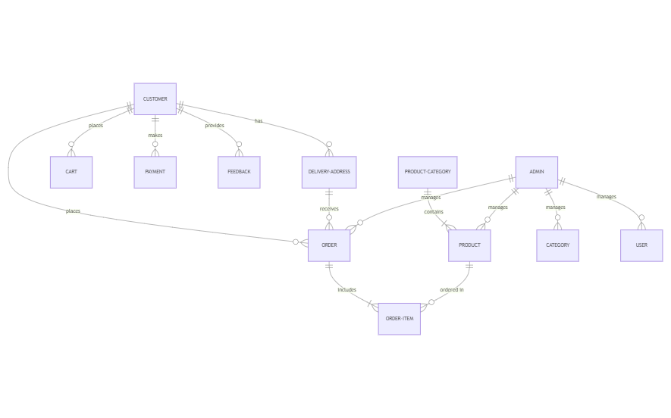
ER Diagram:

Slide 14
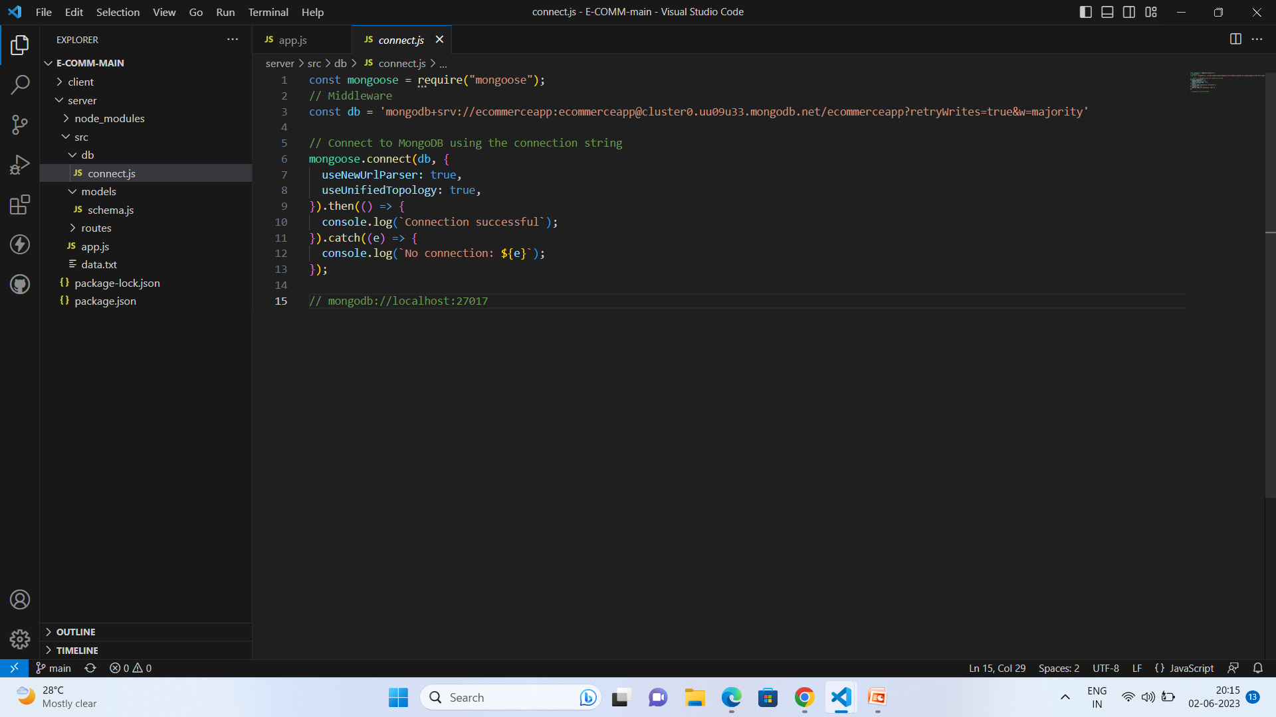
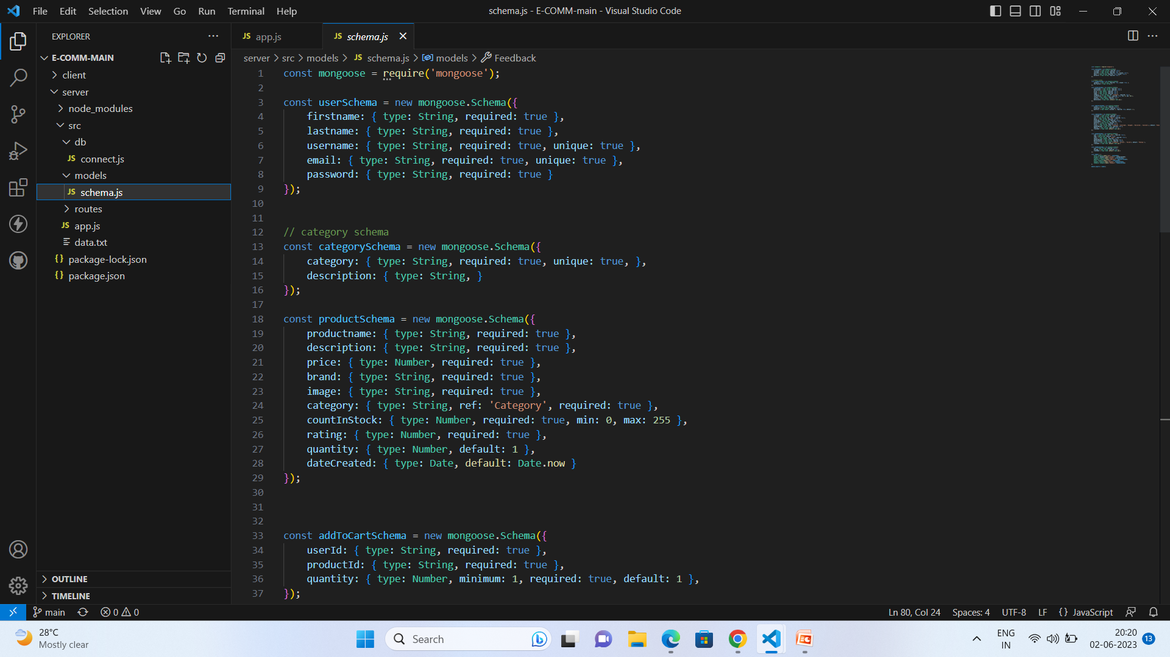
Backend Explanation with code snippets:
Database Connection:
Schemas:

Slide 15
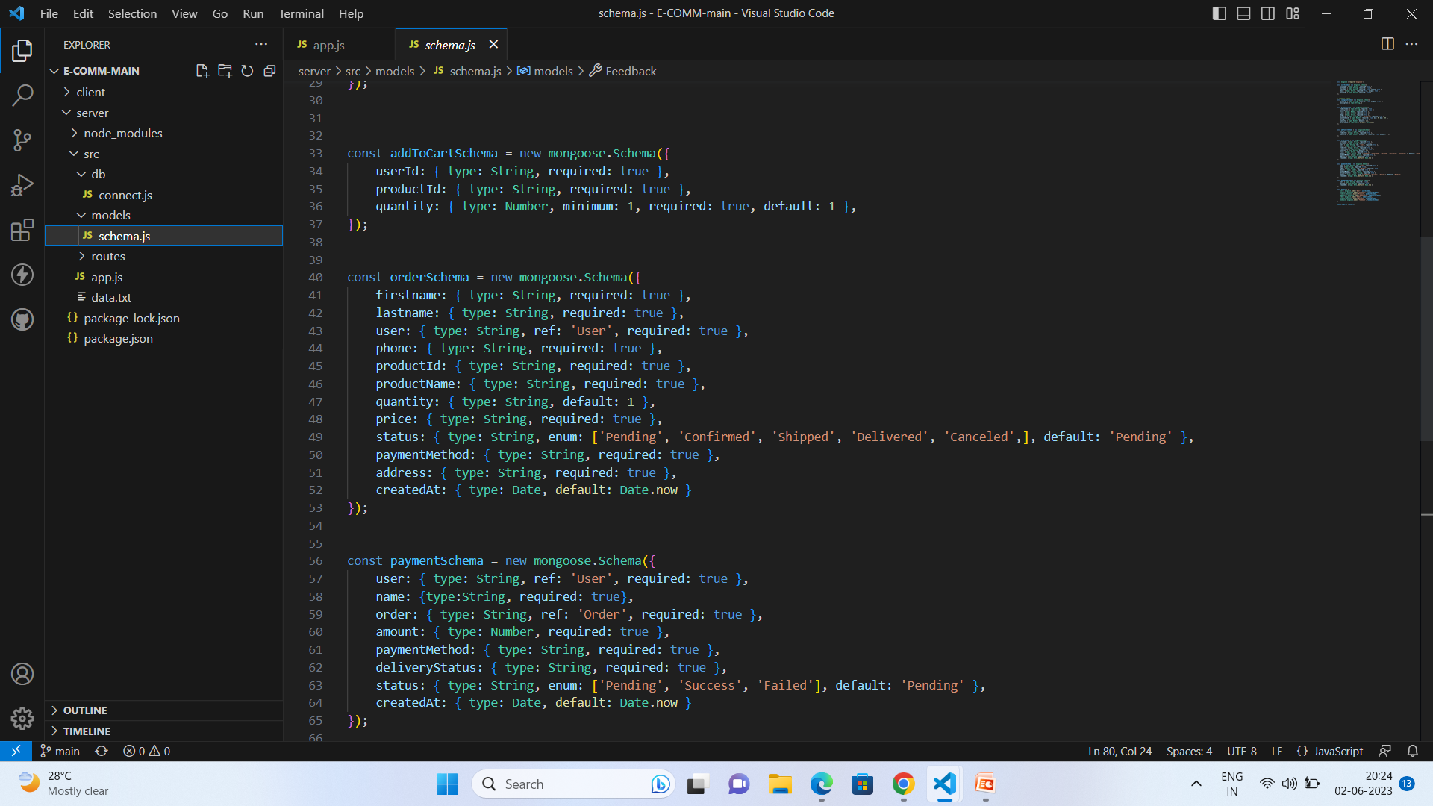
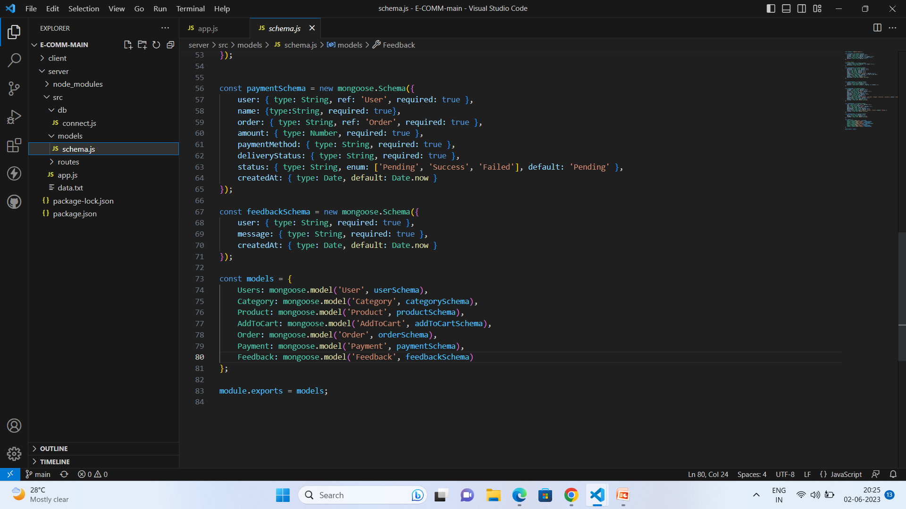

Slide 16
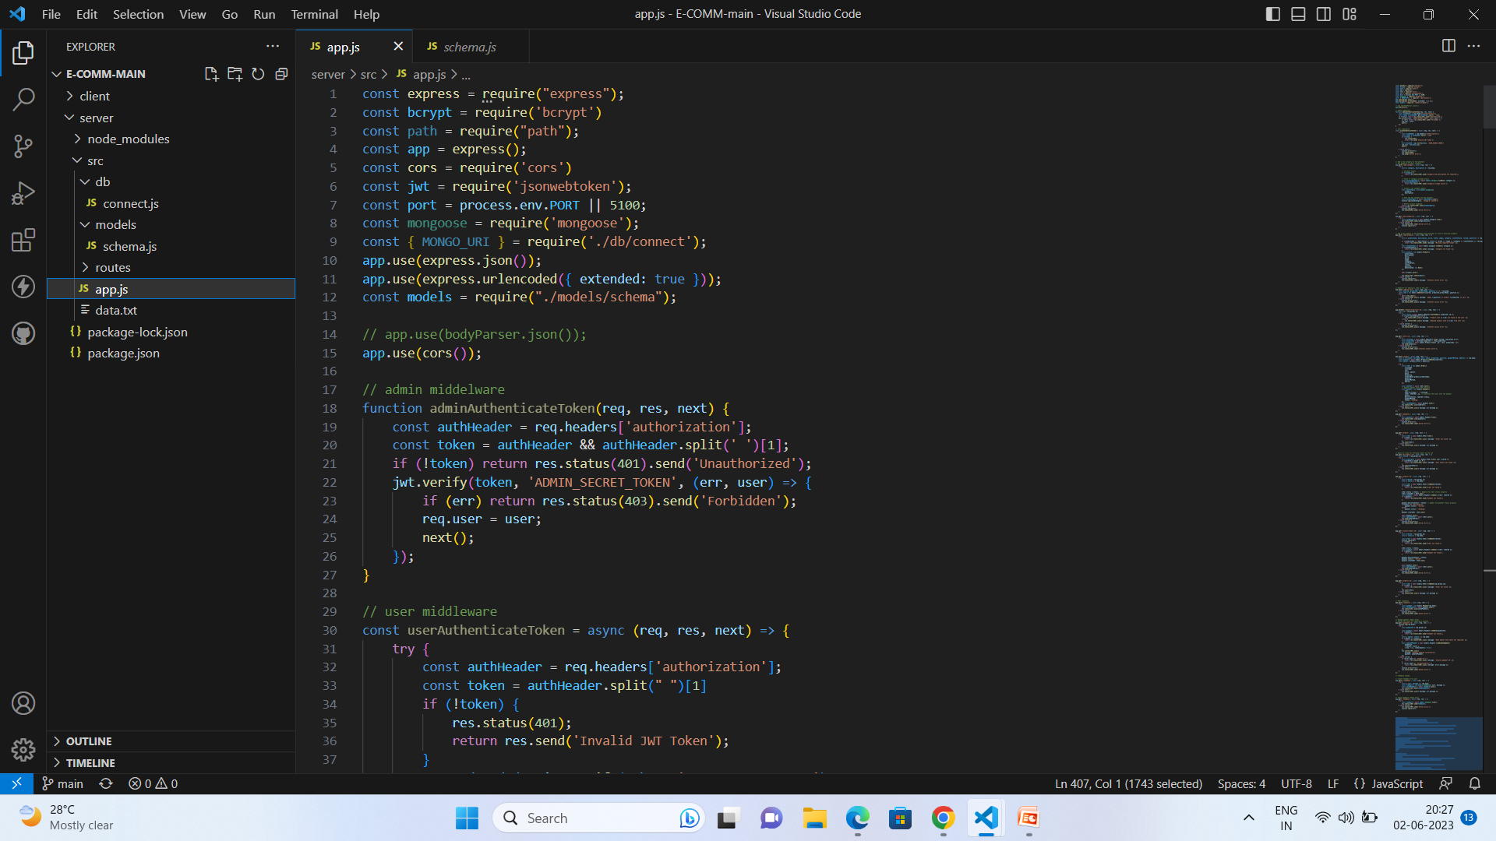
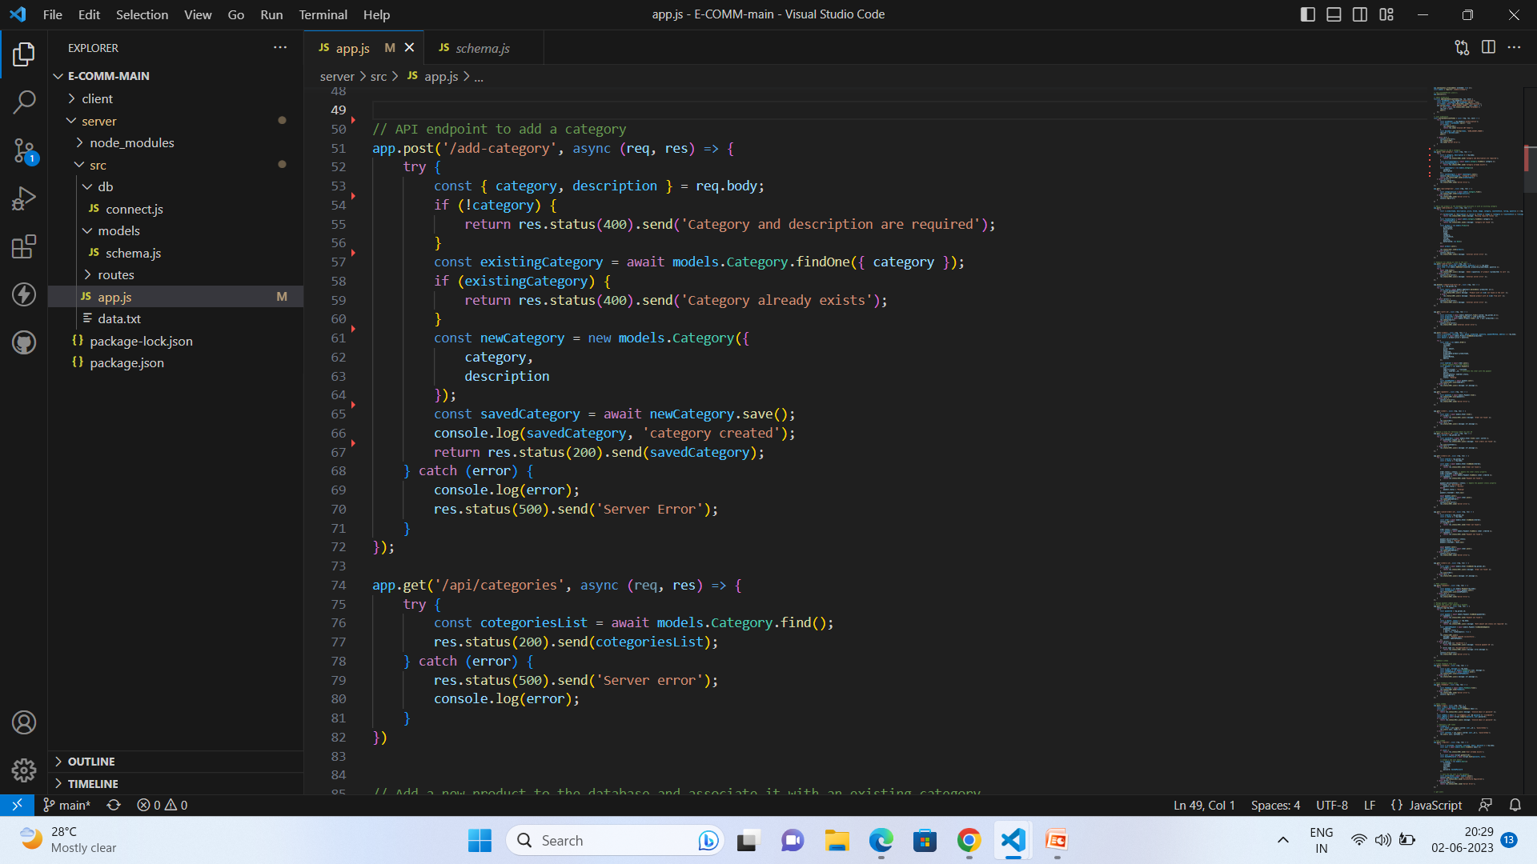
Code Snippets for API’s:
Handling with cors and importing required packages:
Add Category API and Get Category API:
The Add Category API enables category creation and addition to a system, while the Get Category API retrieves specific category details from the system.

Slide 17
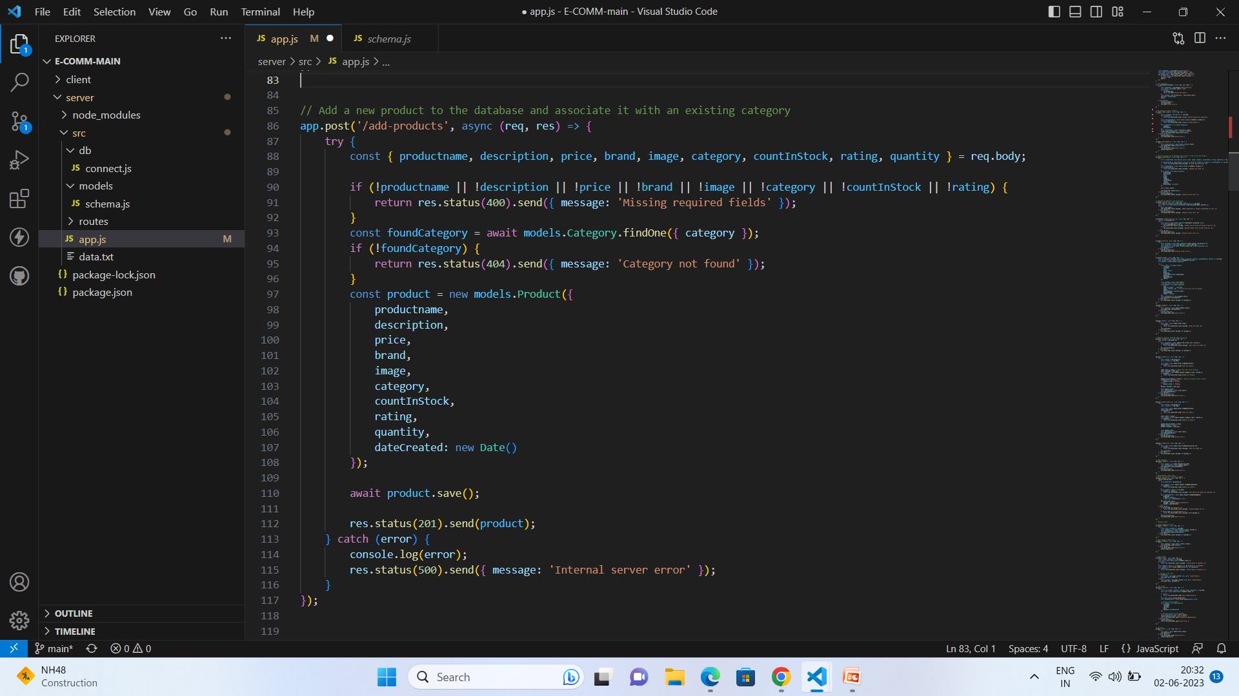
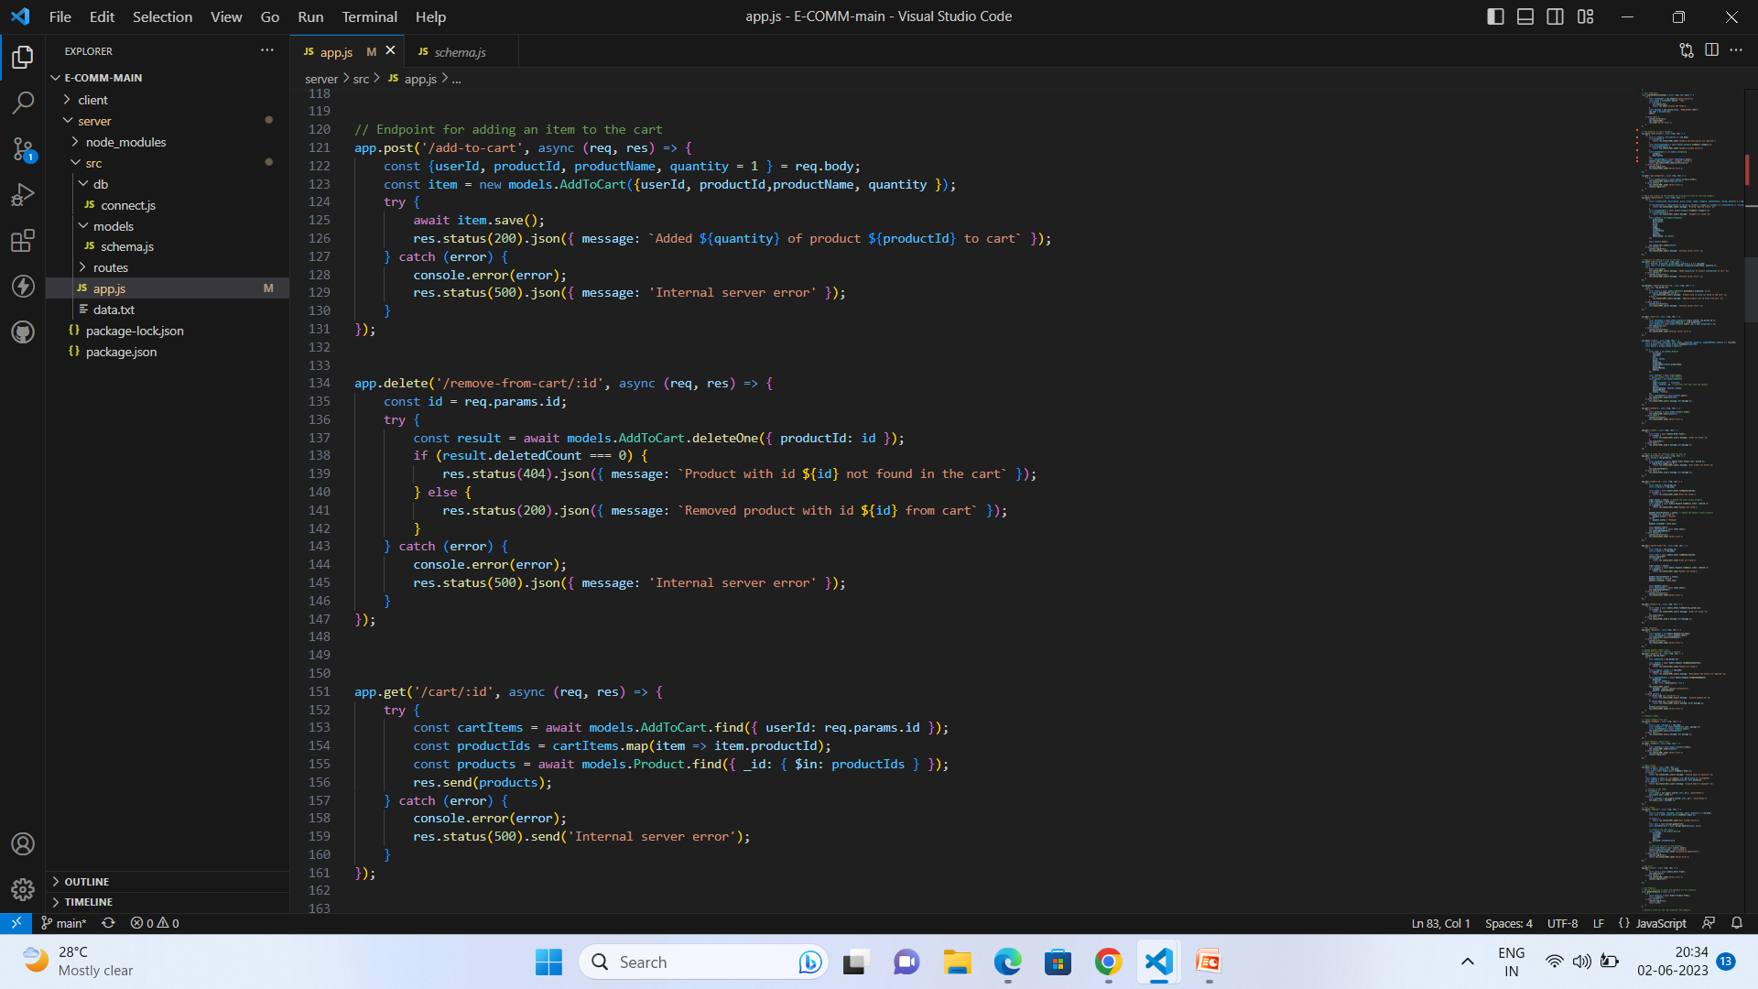
API’s for Add Product:
The Add Product API enables users to create and add a new product to a system or database.
API’s for Add to Cart, Remover from cart and get cart by id:
The Add to Cart API enables users to add items to a cart, the Remove from Cart API allows users to remove items from a cart, and the Get Cart by ID API retrieves the cart details based on the provided ID.

Slide 18
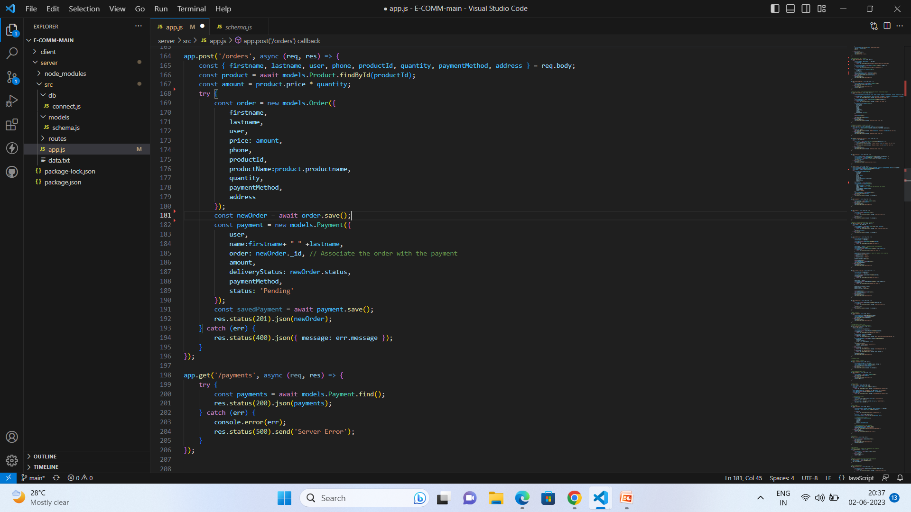
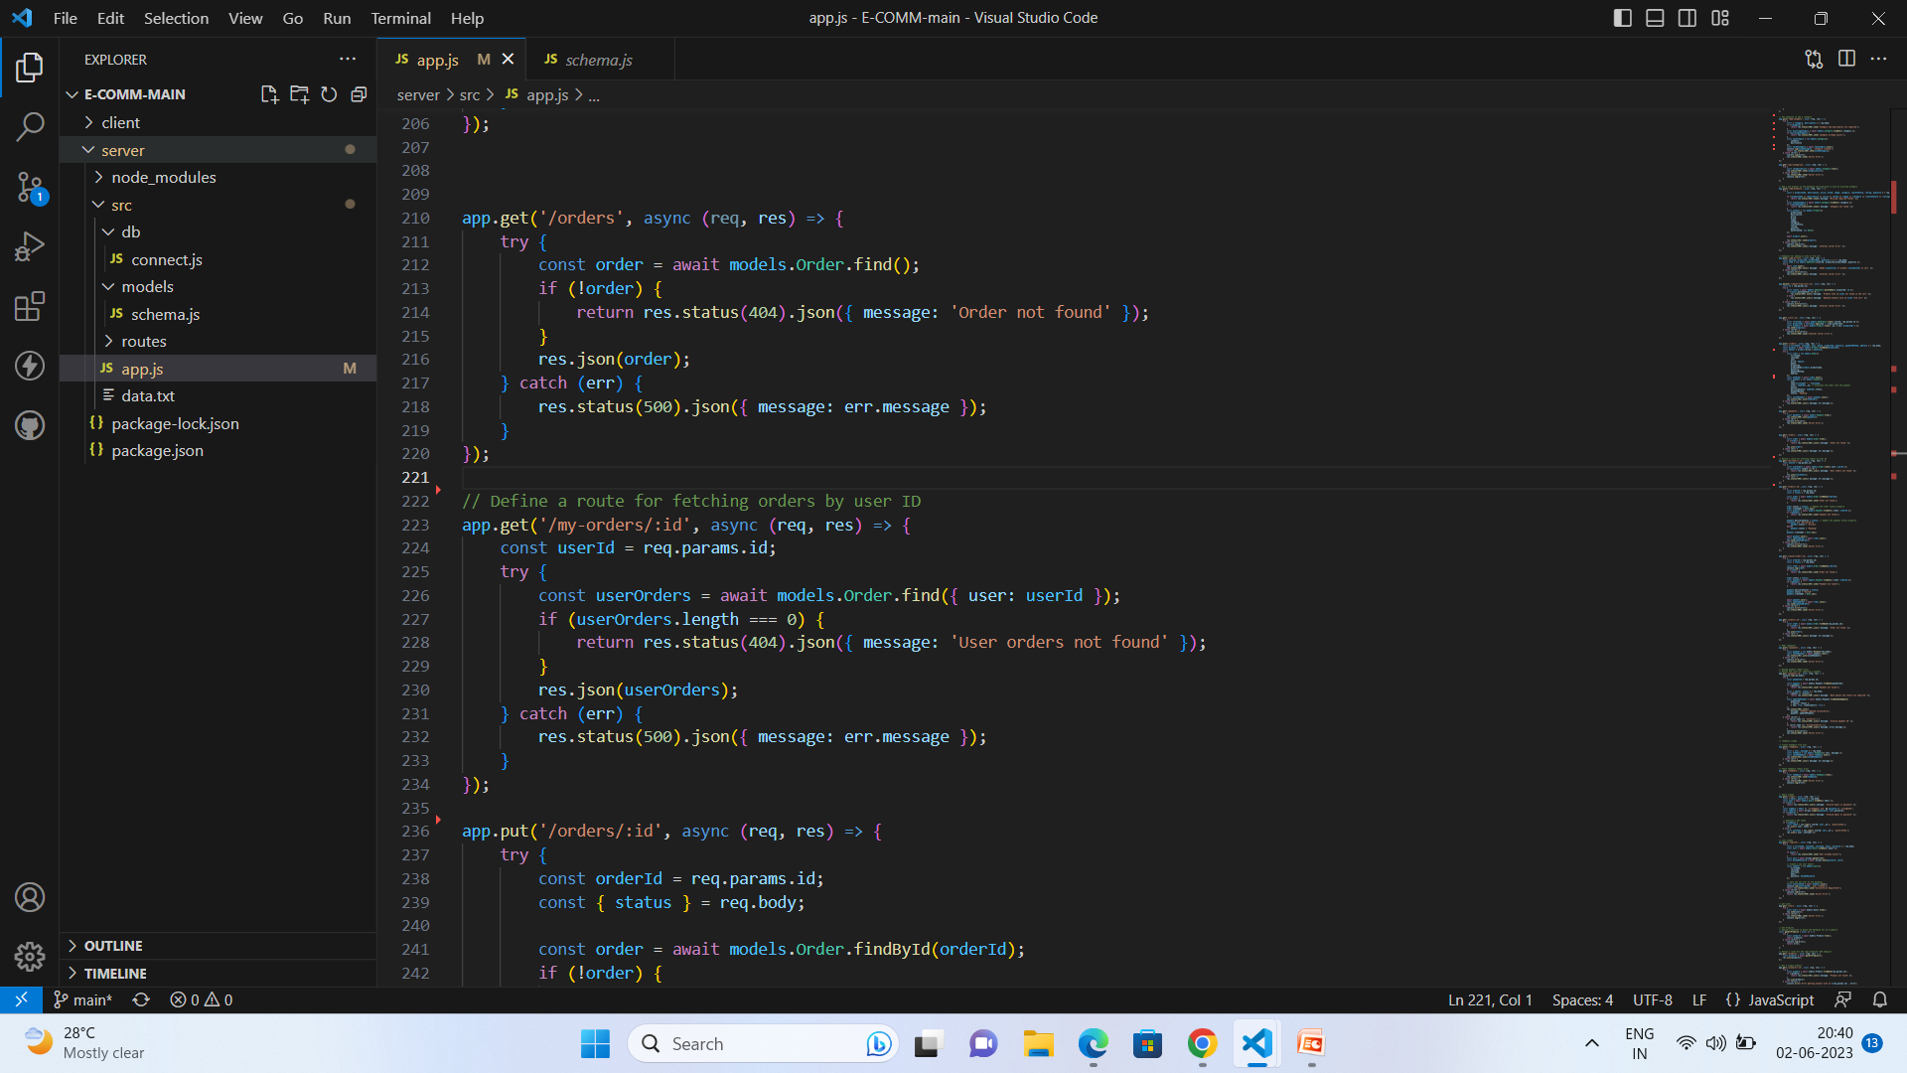
API’s for Post Orders and Get Payments:
The Post Orders API is used to create and submit new orders, while the Get Payments API retrieves payment information for specific orders.
API’s for Get orders and get orders based on user Id:
The Get Orders API retrieves all orders from the system, while the Get Orders by User ID API retrieves orders specific to a user ID.

Slide 19
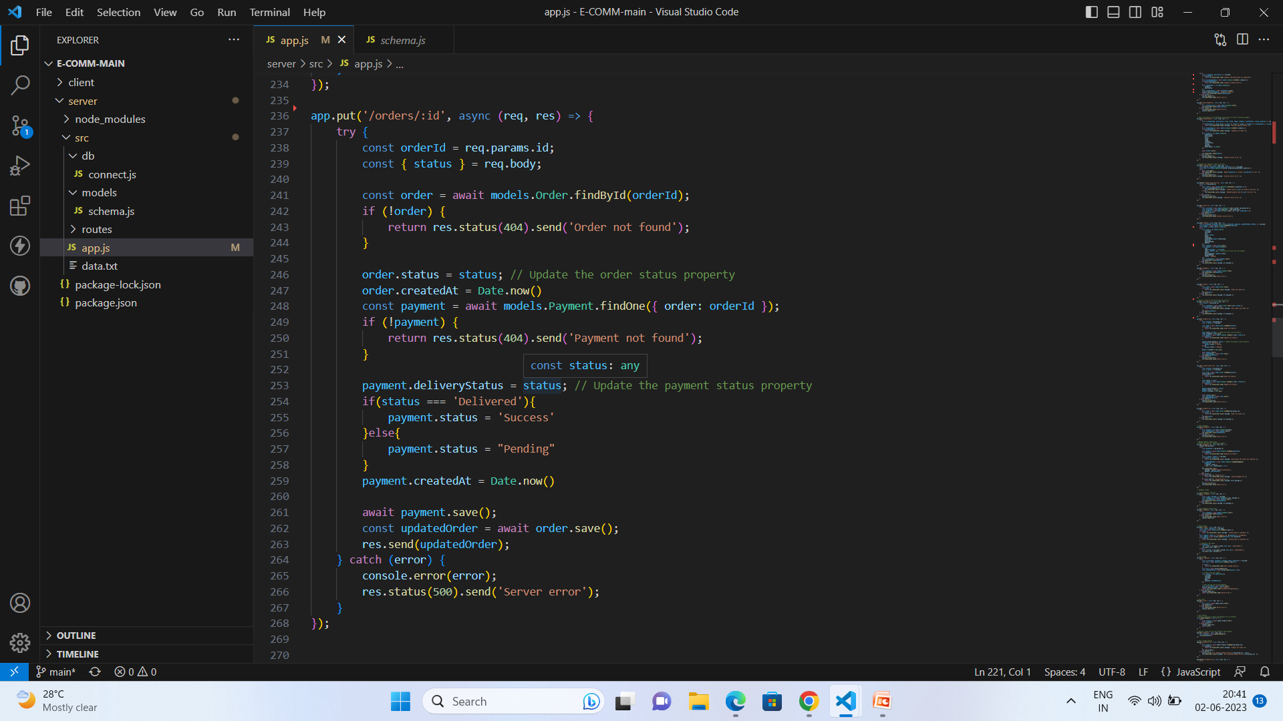
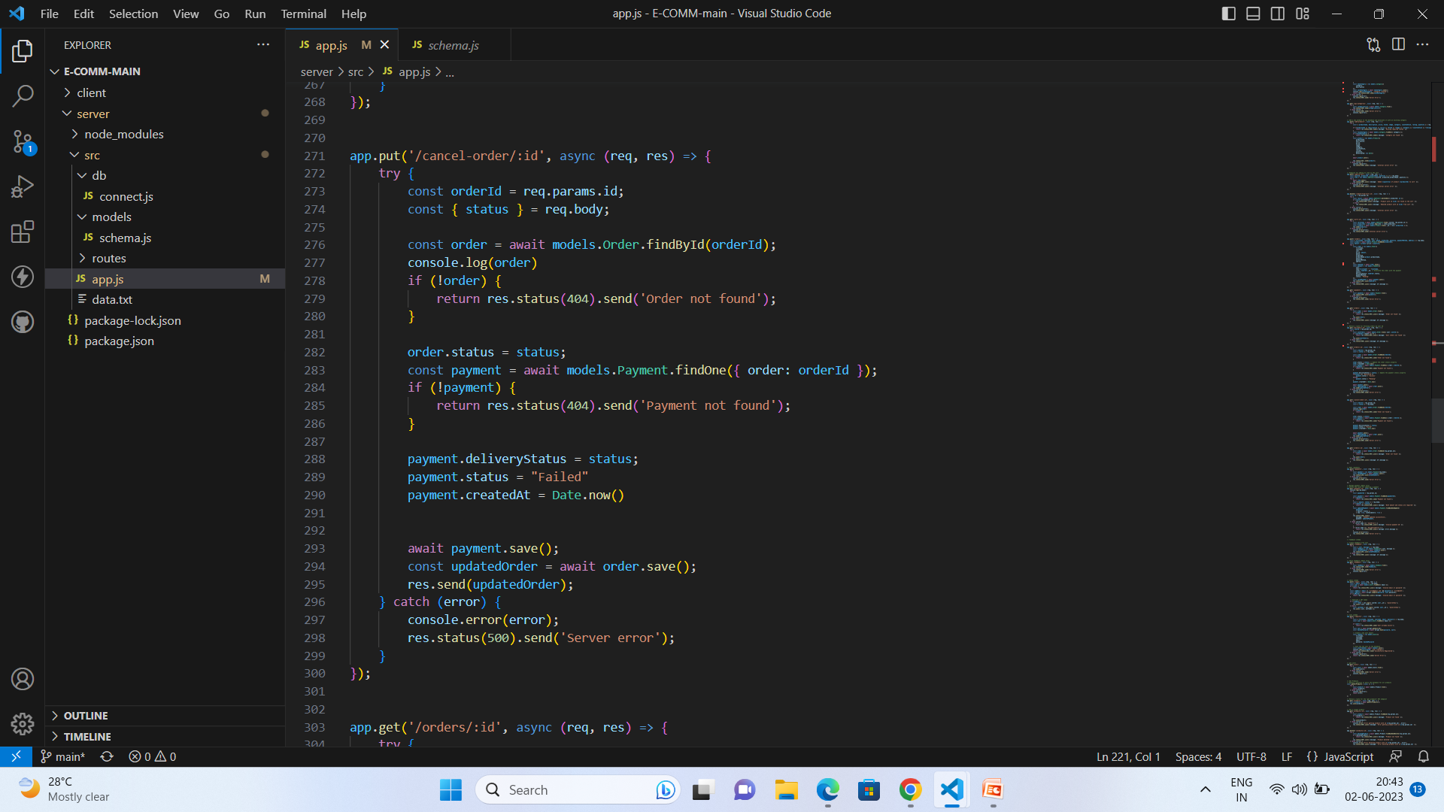
API for Update order based on Id: The Update Order API allows users to modify an order based on its unique ID.
API for cancel order based on Id:
The cancel Order API enables users to cancel an order by its unique ID.

Slide 20
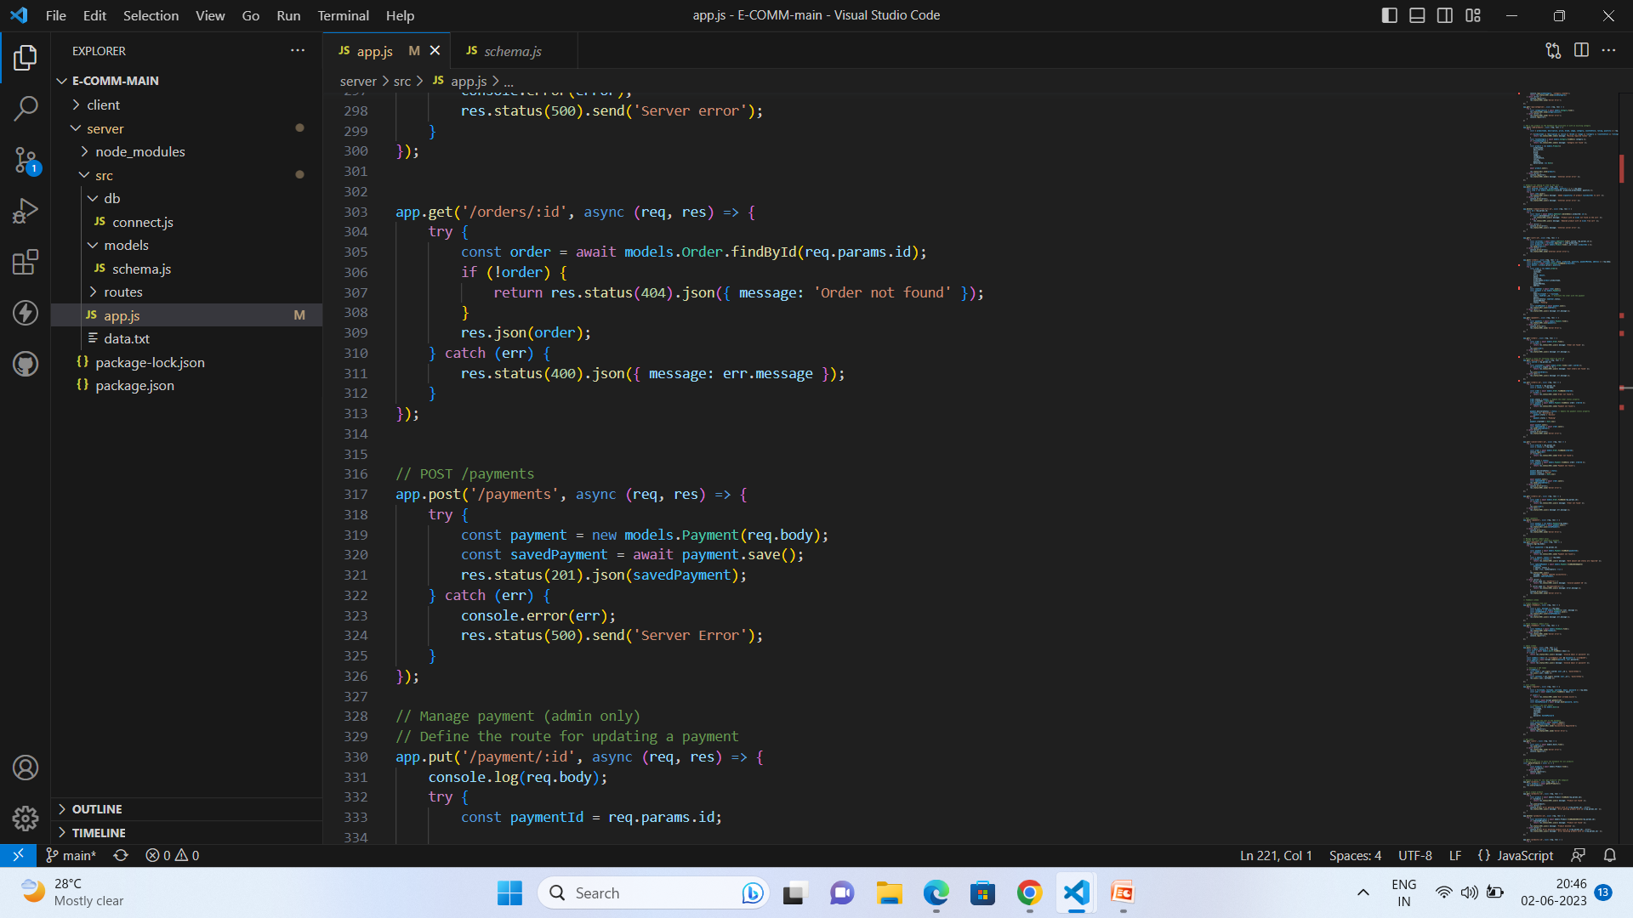
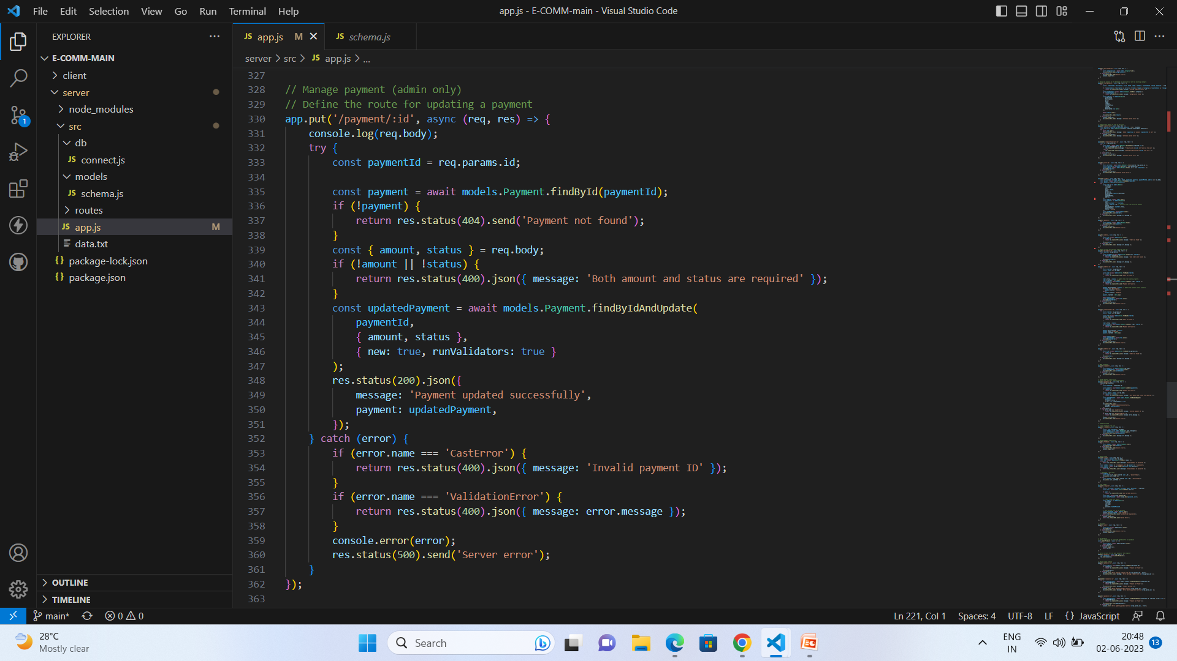
API’s for Get orders based on user Id and post payment:
The Get Orders API retrieves orders based on user ID, while the Post Payment API processes and records a payment transaction.

Slide 21
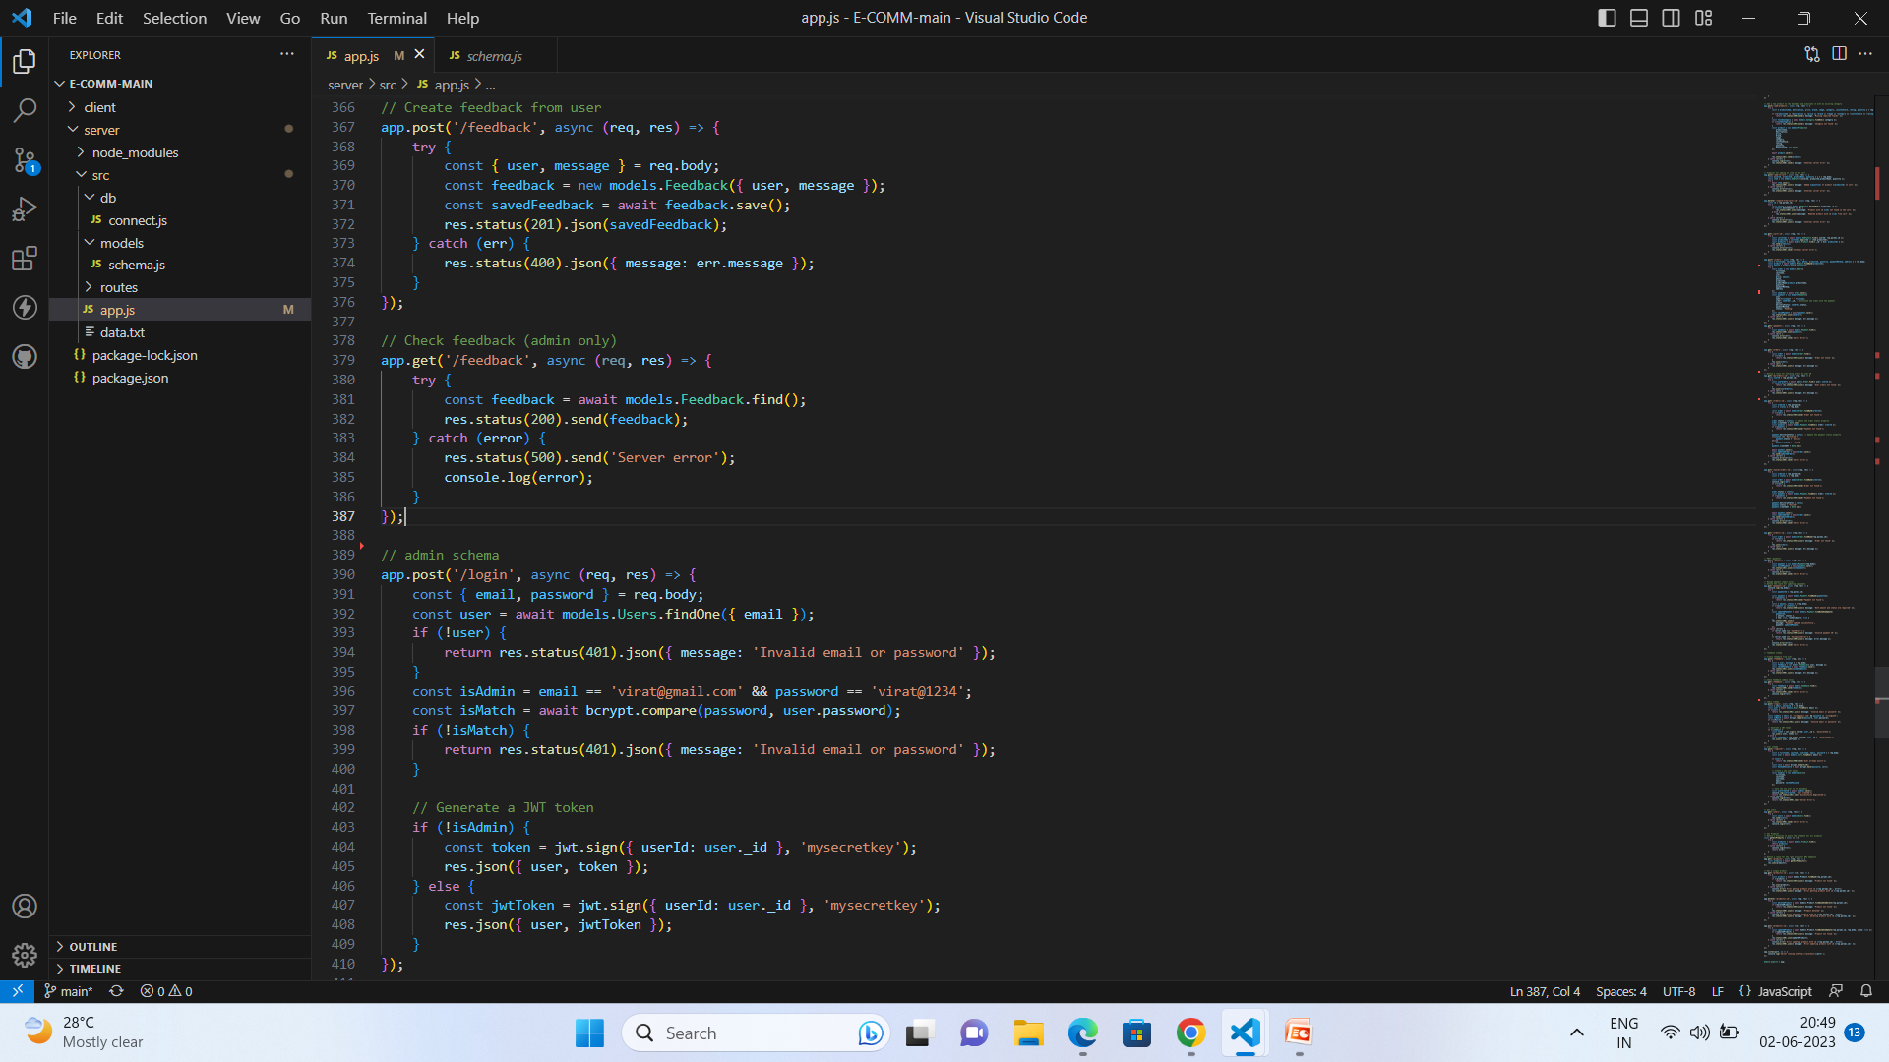
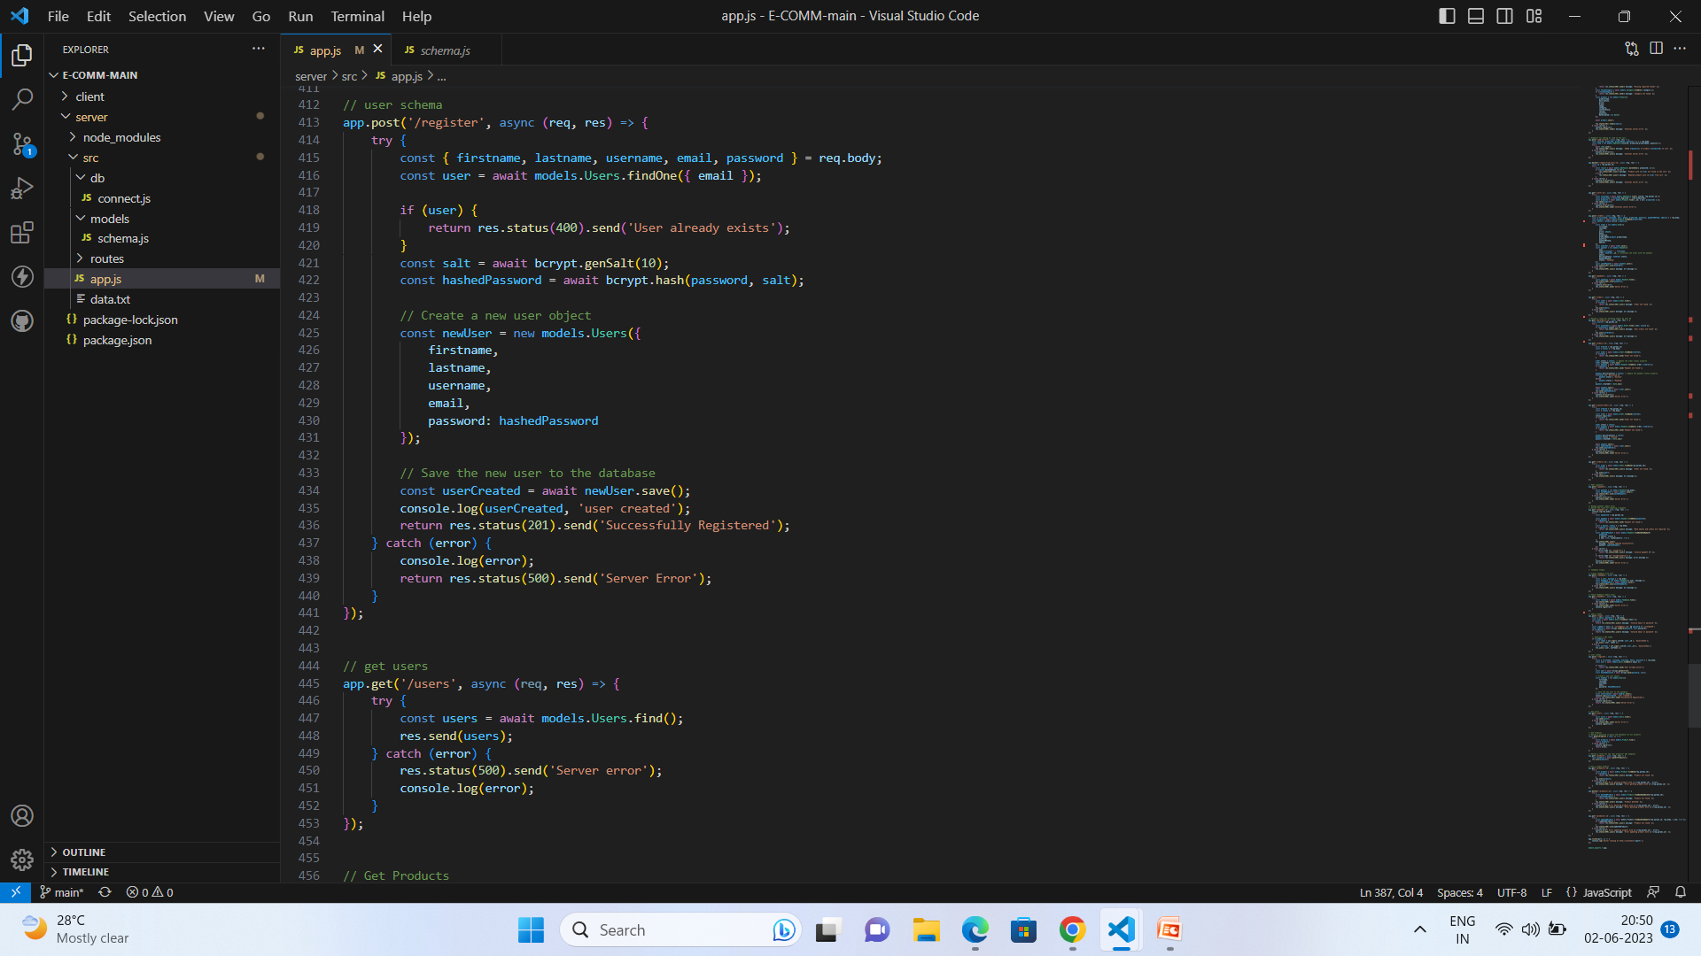
API’s for feedback and login:
The Feedback API enables users to submit feedback or suggestions, while the Login API allows users to authenticate and access secured areas of an application or website.
API’s for Register and get Users:

Slide 22
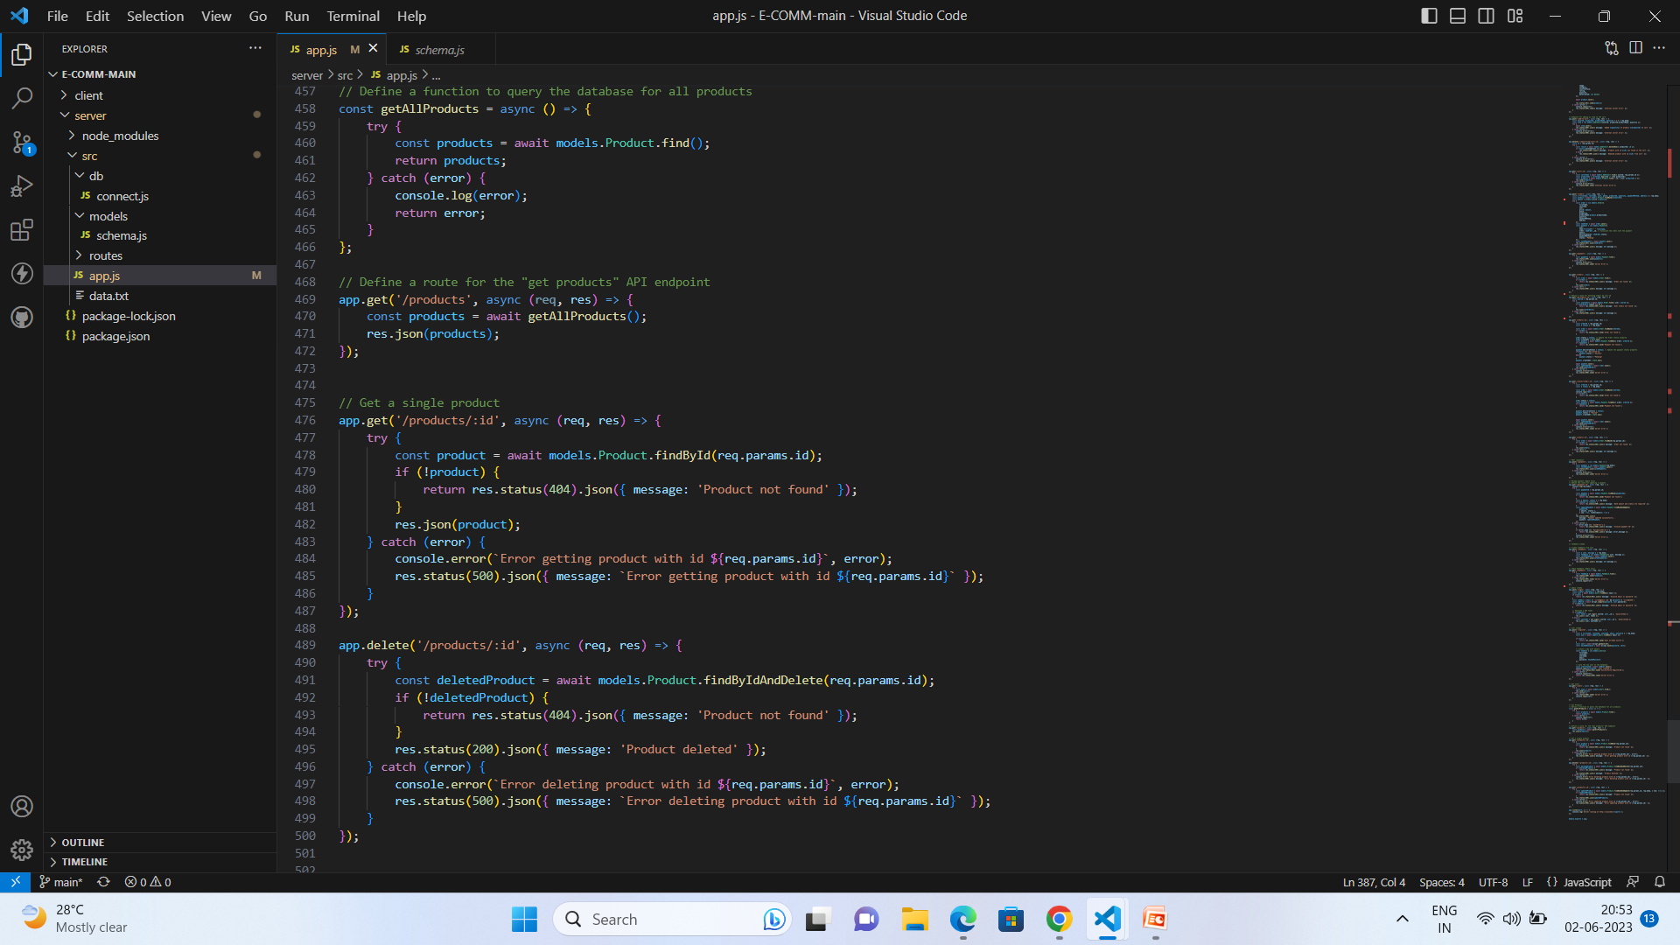
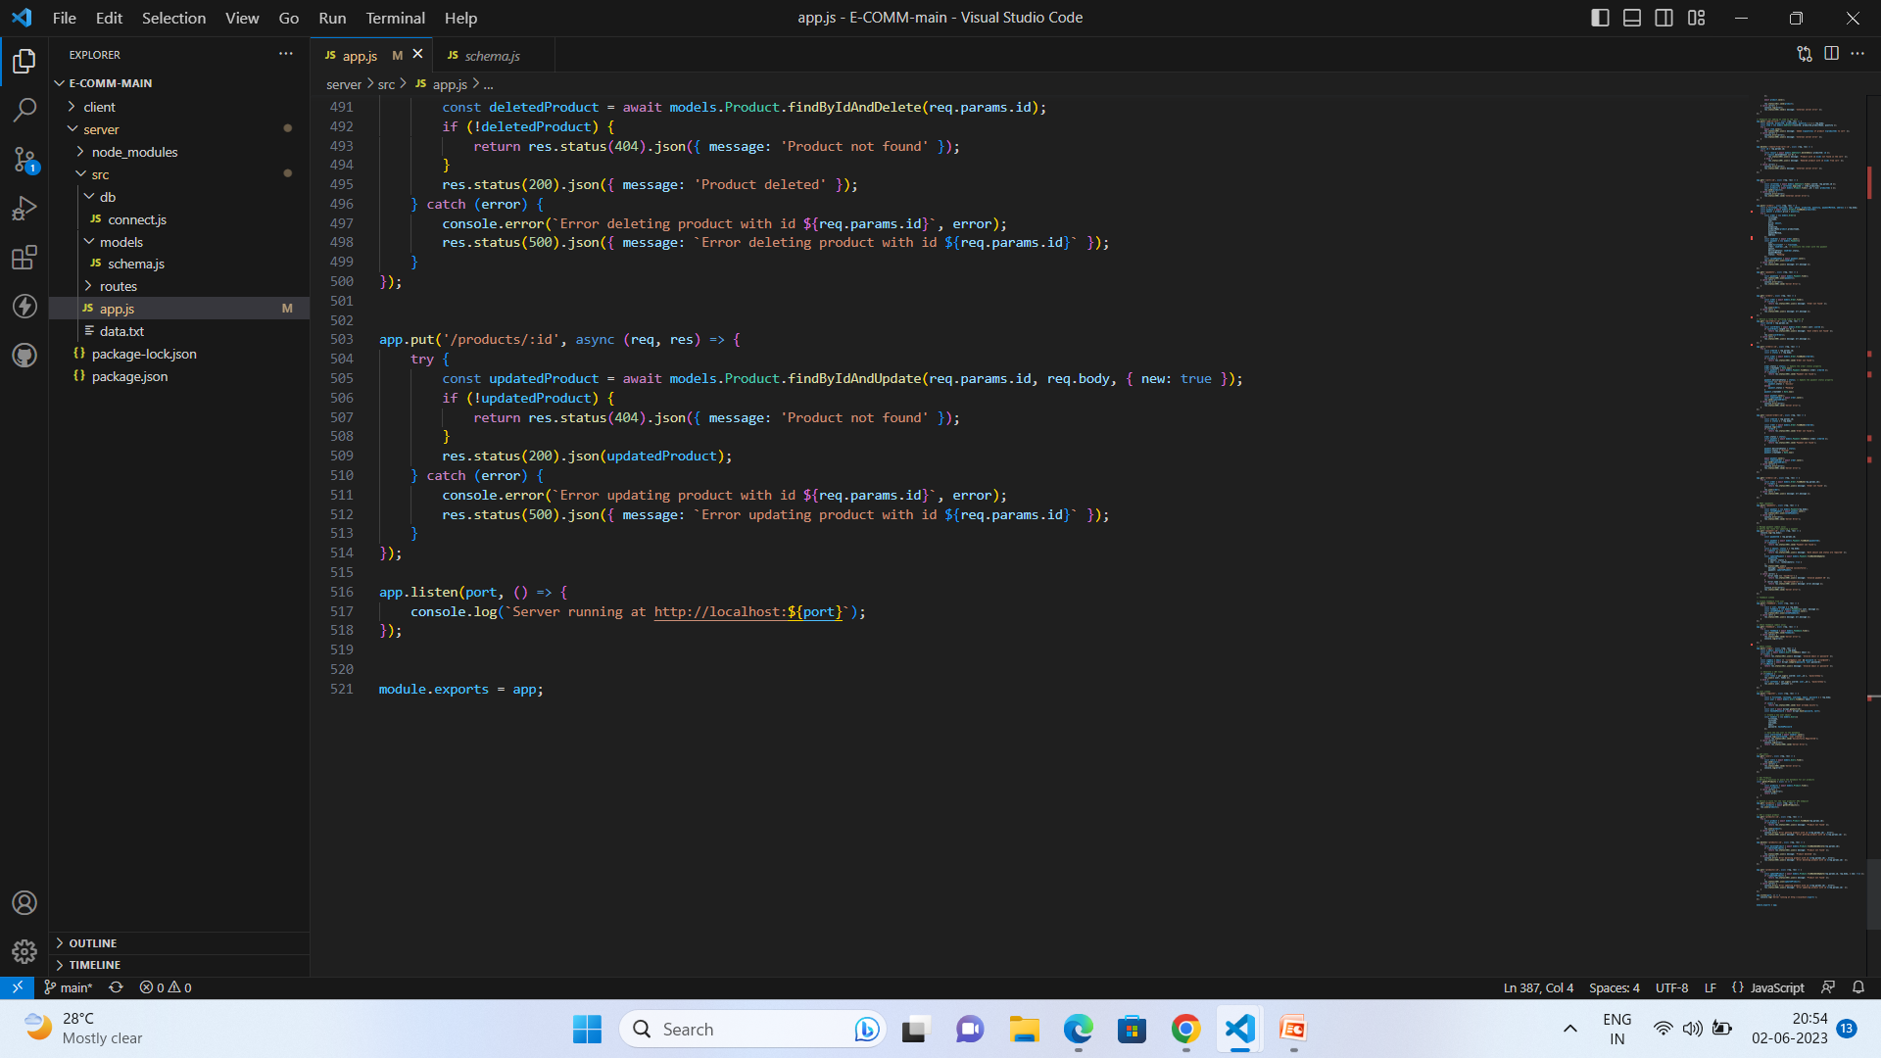
API’s for Products:
The Product API enables users to perform various operations related to products, such as creating, updating, deleting, and retrieving product information from a system or database.
END.

Slide 23
Web Integration:
Web integration typically refers to the process of integrating different web-based systems or services to work together seamlessly. It involves connecting various components, modules, or APIs to create a unified and functional web application. Here are some common aspects of web integration:
API Integration: Many web applications rely on integrating external APIs (Application Programming Interfaces) to access data or functionality from third-party services. This can involve integrating payment gateways, social media APIs, mapping services, or other web services.
Database Integration: Web applications often require integration with a database system to store and retrieve data. This integration involves establishing a connection with the database, designing the database schema, and implementing queries to interact with the data.
User Authentication and Authorization: Web integration includes implementing user authentication and authorization mechanisms. This involves integrating with authentication services or frameworks to handle user registration, login, and session management. Authorization mechanisms control user access to different parts of the application based on their roles and permissions.
Content Management Systems (CMS): Integration with a CMS allows web applications to manage and update content dynamically. This involves integrating the web application with a CMS platform, such as WordPress, Drupal, or custom-built CMS systems, to enable content creation, editing, and publishing.
Payment Integration: E-commerce web applications often require integrating with payment gateways to facilitate secure online transactions. This involves integrating with payment service providers and implementing the necessary workflows to handle payments, order processing, and transaction notifications.
External Service Integration: Web applications may need to integrate with various external services, such as email services, SMS gateways, cloud storage providers, or analytics platforms. This integration allows the application to leverage additional functionality and enhance user experience.

Slide 24
Data Synchronization: Web integration may involve synchronizing data between different systems or services to ensure consistency. This can include integrating with external APIs to fetch or push data, performing scheduled data imports or exports, or implementing real-time data synchronization mechanisms.
Frontend Integration: Web integration also includes integrating frontend technologies, such as HTML, CSS, and JavaScript frameworks, to develop a responsive and interactive user interface. This involves integrating frontend code with backend services, APIs, and data sources.
Testing and Quality Assurance: As with any software development, thorough testing and quality assurance processes are crucial for web integration. This includes testing the integration points, handling edge cases, and ensuring data integrity and security.
Web integration can vary significantly depending on the specific requirements of the project and the technologies being used. It often requires coordination between developers, designers, system administrators, and third-party service providers to ensure successful integration and a seamless user experience.

